Slide 1

MAT203: Linear Algebra
The Geometry of Linear Equations
An Overview of Key Ideas
n linear equations with n unknowns
Row Picture
Column Picture
Vectors
Matrices
Subspaces
In Ryu
September 21, 2016

Slide 2
The Geometry of Linear Equations
To Solve n linear equations in n unknowns

Slide 3
Row Picture

Slide 4
Column Picture

Slide 5
Row Picture

Slide 6
Column Picture

Slide 7
Column Picture

Slide 8
Linear Independence

Slide 9
Matrix Picture

Slide 10
Vectors

Slide 11
Matrices

Slide 12
Matrices

Slide 13
Matrices

Slide 14
Matrices

Slide 15
Matrices

Slide 16
Matrices

Slide 17
Matrices

Slide 18
Matrices

Slide 19
Vector Spaces and Subspaces

Slide 20
Vector Spaces and Subspaces

Slide 21
Vector Spaces and Subspaces

Slide 22
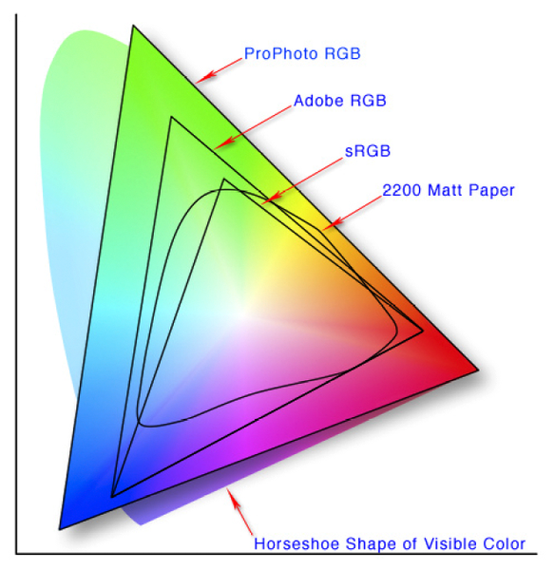

Color Space

Slide 23

Q & A

